Slide 1


Analysis of Puerto Rico’s Status of Electrical Infrastructure SURE C^2 Daniel Barreiro
Onix González
Mentors: Prof. Jorge Feliciano
Dra. Carmen Caiseda

Slide 2
Agendas
Introduction
3
Data Analysis
4
Visualizations
6
Results and Discussion
13
References
14

Slide 3
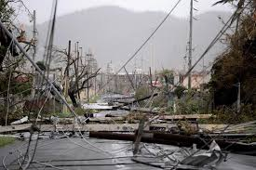
Introduction
3
September 20, 2017, Puerto Rico got hit by the worst natural disaster in recent history Hurricane Maria
All the Island lost power for months
Believed the longest blackout in U.S. history and loss of lives
These events highlight need for a resilient system
Objective: quantify the recovery of the electrical infrastructure and suggest potential solutions

Slide 4
Data Management
Database search
Data cleaning
Data analysis

Slide 5
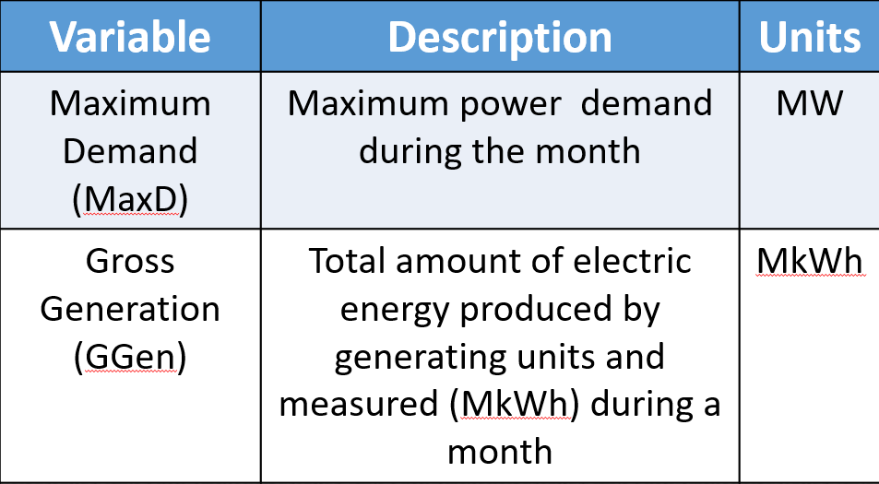
Data analysis - collection
We extracted Puerto Rico’s Electrical grid data from the PR Institute of Statistics; provided by the island’s current electrical distribution manager, LUMA Energy.

Slide 6
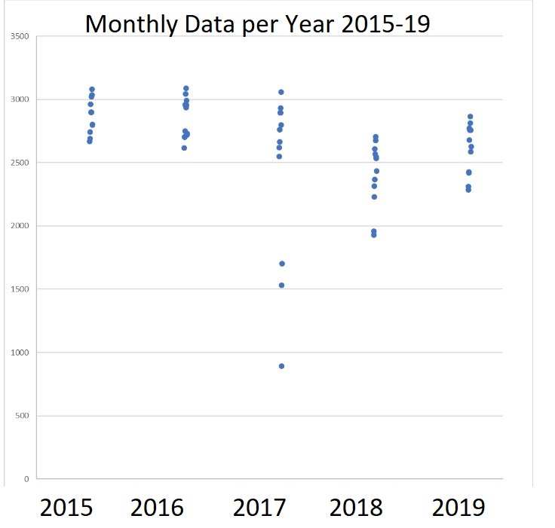
Excel Visualizations of Max Demand and Weather Data

Slide 7
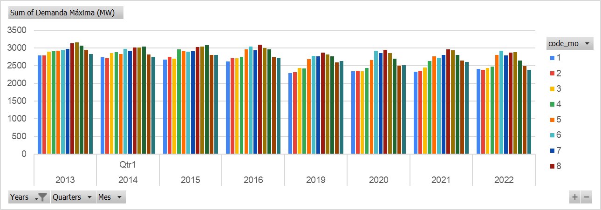
Excel Visualizations of Max Demand and Weather Data
Seasonality of MaxD from Years 2013-2016, & 2019-2022

Slide 8
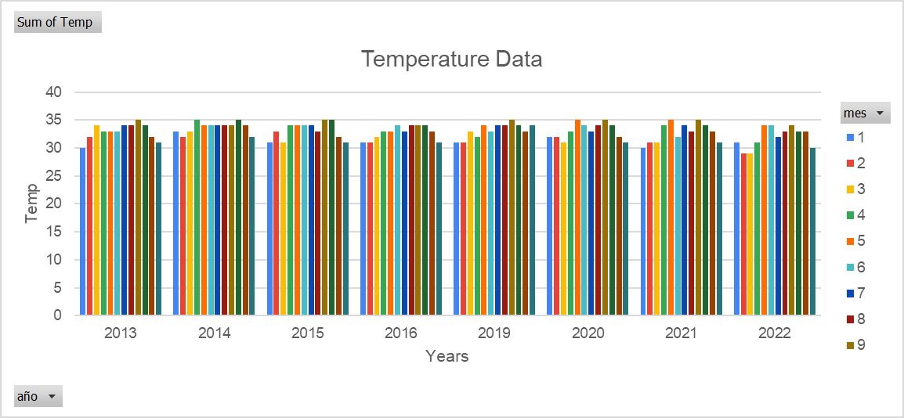
Excel Visualizations of Max Demand and Weather Data
Seasonality of Peak Temperature Weather Data of PR for Years 2013-2016, & 2019-2022.

Slide 9
Comparison of Max Demand and Weather Data in Excel

Slide 10
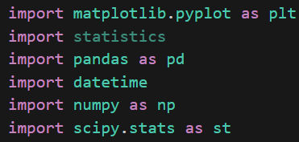
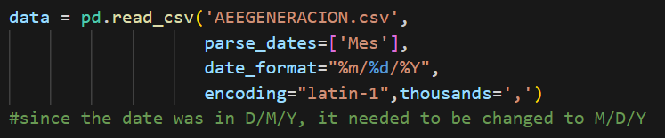
Python – Date formatting
A variety of Python libraries were imported to work with math, plotting and statistics
Code used to standardize the date in the U.S. format of m/d/y

Slide 11
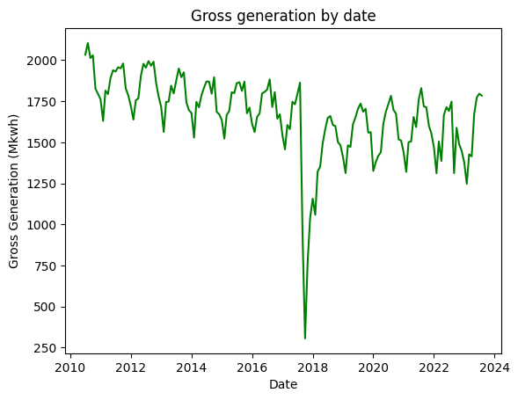
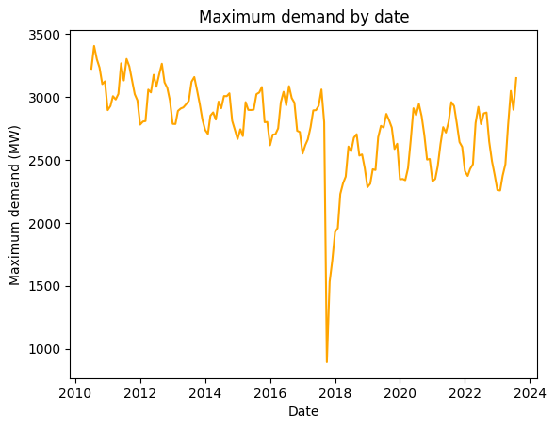
Python – plots of Gross generation and max demand

Slide 12
Python – T test pre and post hurricane
Measure | Maximum D | Gross Generation
Mean ± t-critical* SE (Pre,Post) | 2940 ± 31.15 MW 2627 ± 50.12 MW | ± 23.11 MkWh ± 34.43 MkWh
Variance Pre Variance Post | 2.52 E4 4.36 E4 | 1.40 E4 2.07 E4
Observations (Pre,Pos) | (72, 48) df = 82 | (72,48) df = 118
T-stat P-value – One-tail | 8.84 7.48 E-14 | 9.19 8.04 E-16
12

Slide 13
Discussion
Challenges:
Generation has failed to reach its pre-Maria peak
The biggest power plant in the island still relies on fossil machines
Possible solutions:
Capacitor banks to regulate transmission voltage
Develop algorithms that can predict demand spikes and system irregularities
Replace old power generators with renewable energy systems

Slide 14
References
Generation, consumption, cost, income and customers of the Puerto Rico electrical system. (2023, March 13). https://www.indicadores.pr/dataset/generacion-consumo-costo-ingresos-y-clientes-del-sistema-electrico-de-puerto-rico/resource/8025f821-45c1-4c6a-b2f4-8d641cc03df1
Sandoval, R. (2019, 18 septiembre). HOJA DE RUTA DE RECURSOS ENERGÉTICOS DISTRIBUIDOS PARA PUERTO RICO. https://ieefa.org/sites/default/files/2023-01/Hoja-de-ruta-de-recursos-energeticos-distribuidos-para-Puerto-Rico-Fase-I-Final-11_2019.pdf
Irfan, U. (2018, January 4). Puerto Rico and the US Virgin Islands are in the longest blackout in US history. Vox. https://www.vox.com/energy-and-environment/2017/10/30/16560212/puerto-rico-longest-blackout-in-us-history-hurricane-maria-grid-electricity

Slide 15
Thank you for your attention

